Slide 1
Principles of Programming Languages

Slide 2
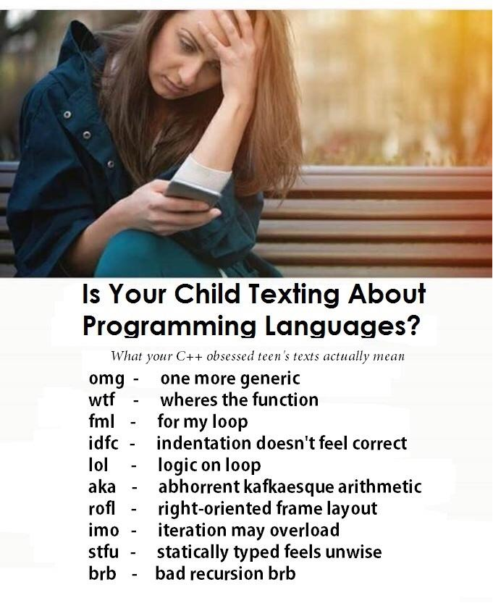

Slide 3
What is this class about?
“Introduction to the design and implementation of programming languages, including language features, paradigms and design decisions. Briefly covers functional and logical programming paradigms and reinforces object-oriented concepts. Discusses interpreters, compilers, transpilers and virtual machines, including lexical analysis, parsing, semantic analysis, optimization, code generation. Introduction to automata and state machines.”

Slide 4
What is this class about?
You learned Java already
Now you are going to learn how programming languages work
How does compiling work
Why are there so many programming languages?
How can I make my own programming language?
Why should I choose Java over Python or JavaScript over Go?

Slide 5
Why should I pay attention to this class?
“C” requirement for later classes
You will use many programming languages in your career
You will probably write a few in your career
Choosing the right language can make coding a problem much easier
Become the go-to person for weird compiler issues
Techniques for programming languages are widely applicable

Slide 6
Be a tool builder
Consider the Industrial Revolution
Craftsmen were replaced by machines
Do you want to design machines and tools or do you want to operate them?

Slide 7
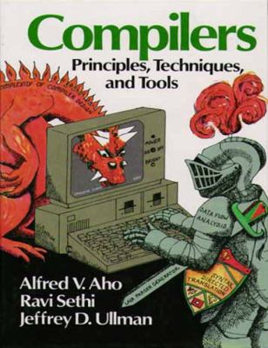
How is this class different?
Classic Computer Science education would focus on making compilers.
Instead, we focus on:
Making small languages
Understand the tools that we use
Classic Computer Science algorithms
How to discuss/choose languages

Slide 8
Why a Software Engineer/Developer needs 311
New languages will keep coming
Java is >25 years old. What’s new?
Write code that writes code
Be the wizard, not the typist
Develop your own language
Seriously? Yup.
Learn about the tools of the trade
These are the tools that you will use for the rest of your career

Slide 9
Millions for compilers but hardly a penny for understanding human programming language use. Now, programming languages are obviously symmetrical, the computer on one side, the programmer on the other. In an appropriate science of computer languages, one would expect that half the effort would be on the computer side, understanding how to translate the languages into executable form, and half on the human side, understanding how to design languages that are easy or productive to use. Yet we do not even have an enumeration of all of the psychological functions programming languages serve for the user. Of course, there is lots of programming language design, but it comes from computer scientists. And though technical papers on languages contain main appeals to ease of use and learning, they patently contain almost no psychological evidence nor any appeal to psychological science.
-The Prospects for Psychological Science in Human-Computer Interaction
Allen Newell, Stuart Card

Slide 10
Modern Research of Programming Languages
Swift and LLVM at Apple
Golang and Dart at Google
PHP (HipHopVM) at Facebook
Rust and JavaScript at Mozilla
Kotlin at JetBrains
F# and more at Microsoft
Wolfram at Wolfram Research
Plus TONS in academic circles

Slide 11
Topics
There are several groups of topics for this course.
The study of programming languages covers a wide variety of material, so grouping makes some sense.

Slide 12
Object Oriented
We will expand on the material in Java to generalize the concepts and practice some of the deeper concepts.
We will take brief looks at some popular object oriented languages, including: C#, Python, JavaScript, Objective C and Smalltalk

Slide 13
Procedural
Back to the beginning, we will talk about successful programming strategies in procedural programming languages.
Examples include Fortan, Cobol and Bash

Slide 14
Functional
Functional programming languages are becoming more popular and their design is influencing mainstream languages.
We will learn Scheme in this course.

Slide 15
Compilers
We will learn the different parts of compilers, including lexical analysis, parsing, semantic analysis, optimizations and code generation.
We will build a simple programming language in this module.

Slide 16
Logical and Fourth Generation
We will look at logical programming and other languages that try to bridge the gap between the way that humans think and computers compute.
Examples include Prolog and SQL.

Slide 17
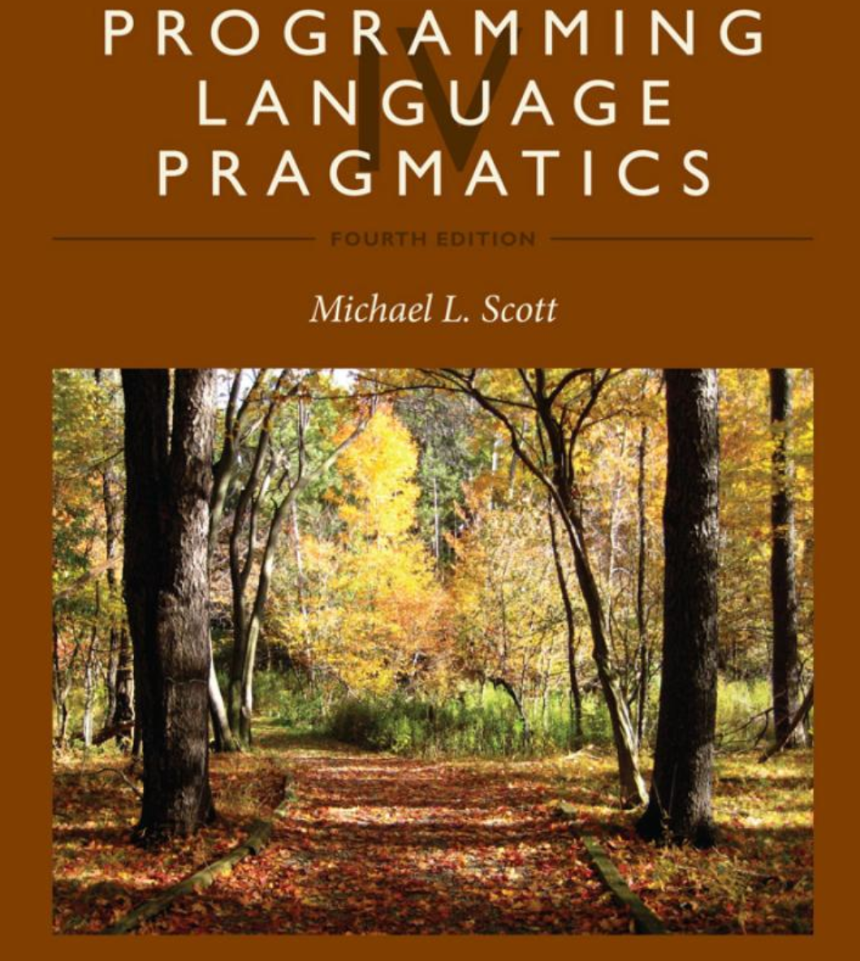
Textbook
Not required
A very good book, though
We won’t cover every bit, (and some material in this class is not in this book) but a lot of material is in common

